Slide 1
Ohio Digital Hubs
Southwest Ohio:
Public Library of Cincinnati & Hamilton County

Slide 2
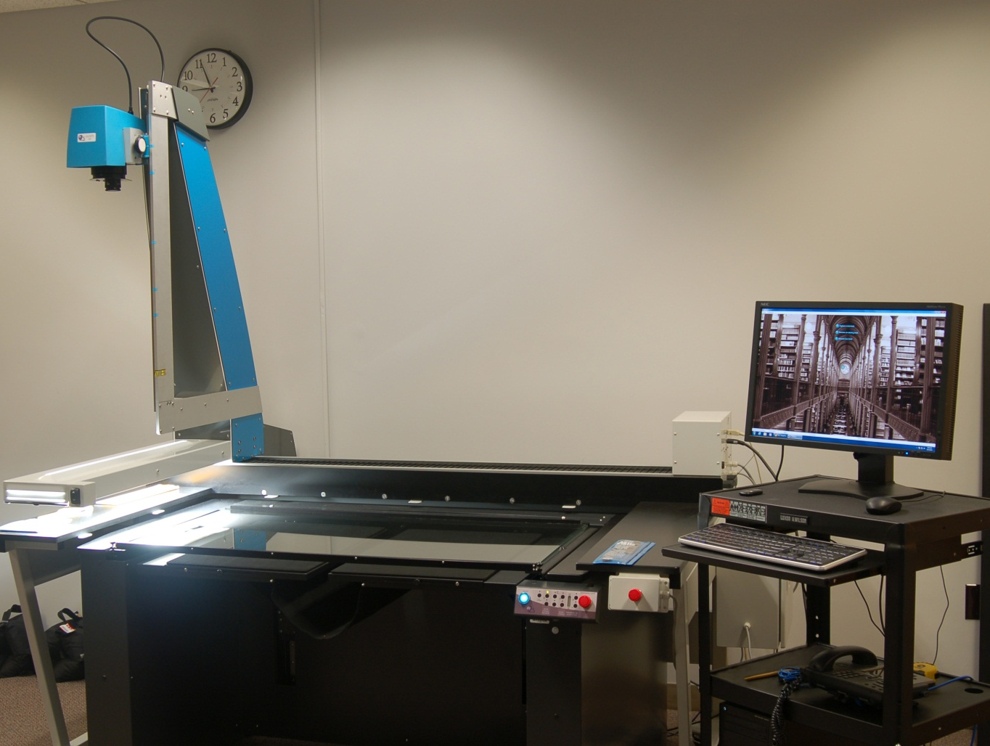
Public Library of Cincinnati & Hamilton County
i2S Suprascan Quartz large format planetary scanner

Slide 3
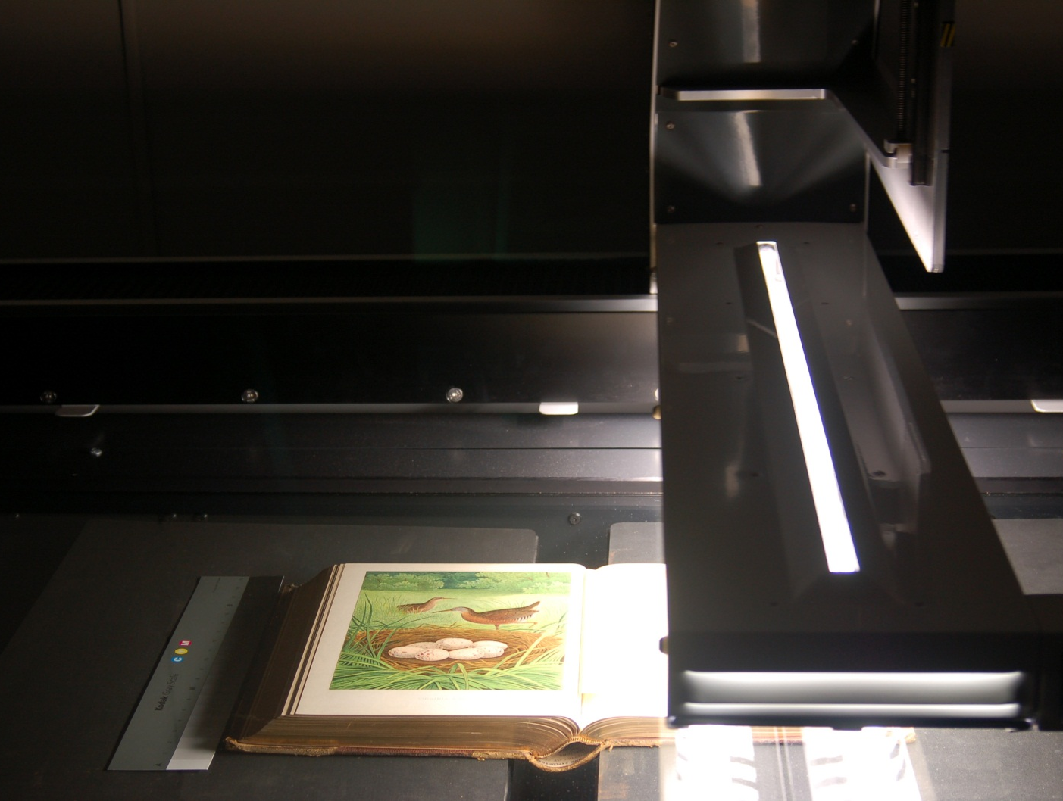
Public Library of Cincinnati & Hamilton County
i2S Suprascan Quartz large format planetary scanner

Slide 4
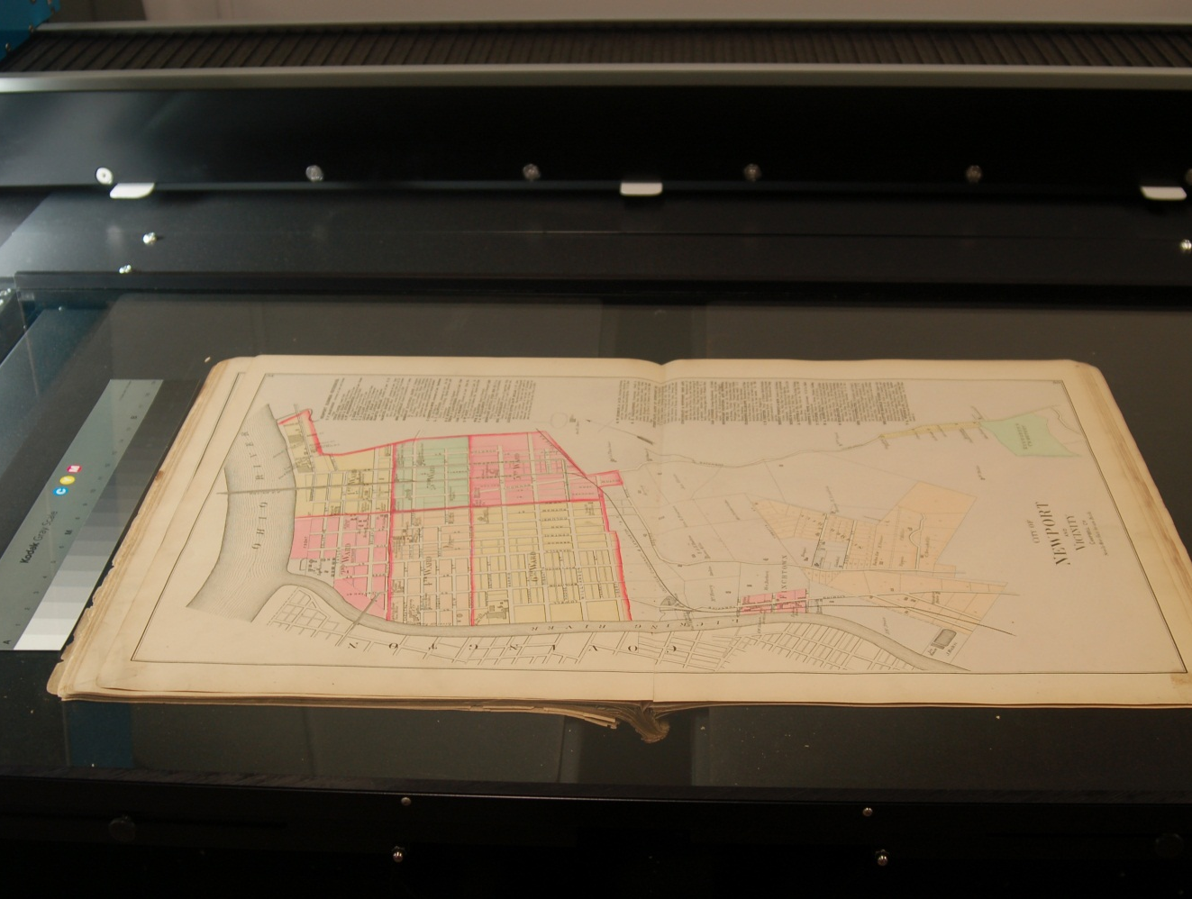
Public Library of Cincinnati & Hamilton County
i2S Suprascan Quartz large format planetary scanner

Slide 5
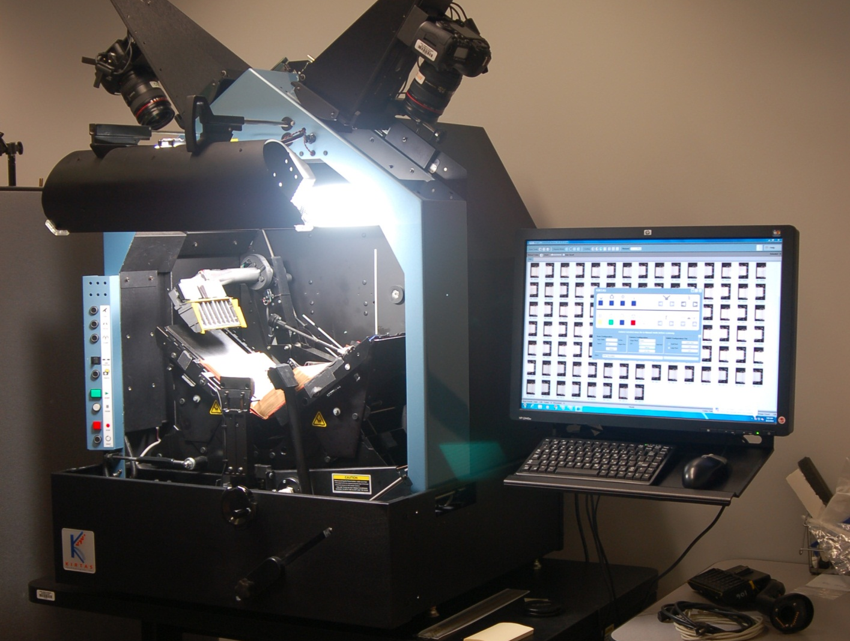
Public Library of Cincinnati & Hamilton County
Kirtas book scanner with upgraded cameras

Slide 6
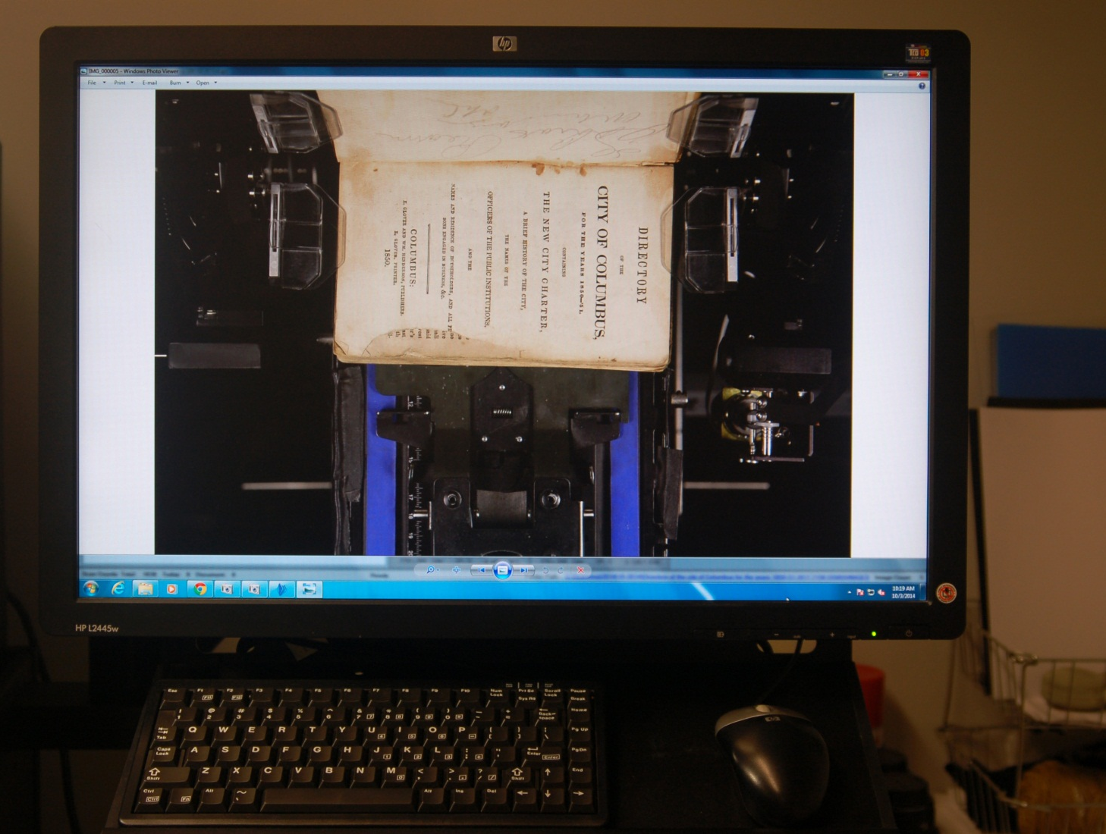
Public Library of Cincinnati & Hamilton County
Kirtas book scanner with upgraded cameras

Slide 7
Ohio Digital Hubs
Central Ohio:
Columbus Metropolitan Library

Slide 8
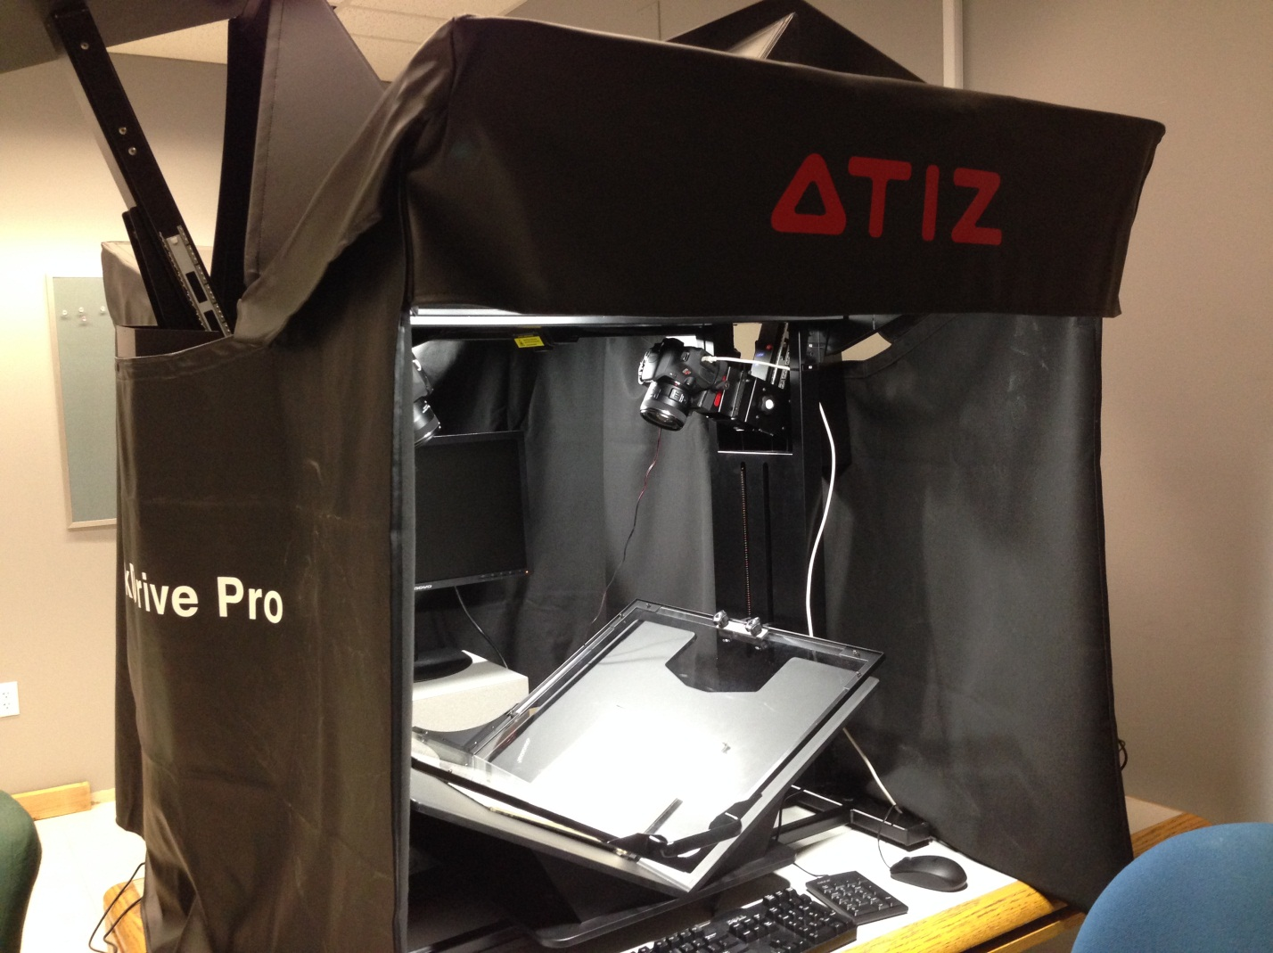
Columbus Metropolitan Library
Atiz Bookdrive Pro

Slide 9
Columbus Metropolitan Library
Cruse CS 220 large format scanner

Slide 10
Columbus Metropolitan Library
48 TB digital storage

Slide 11
Ohio Digital Hubs
Northwest Ohio:
Toledo & Lucas County Public Library

Slide 12
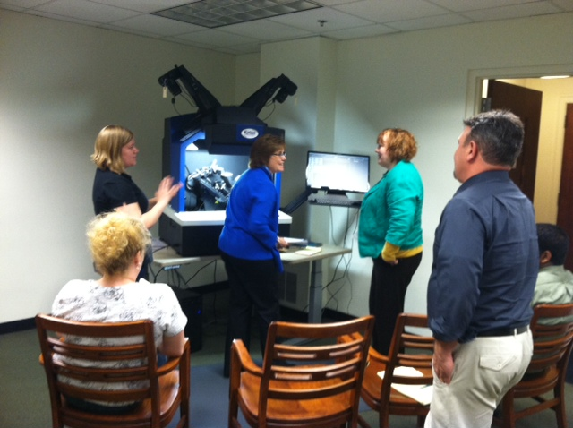
Toledo & Lucas County Public Library
Kirtas KABIS III book scanner

Slide 13
Toledo & Lucas County Public Library
Kirtas i2S SupraScan Quartz large format scanner

Slide 14
Ohio Digital Hubs
Northeast Ohio:
Cleveland Public Library

Slide 15
Cleveland Public Library
text

Slide 16
Cleveland Public Library
text

