Slide 1
DPLA Models & the Metadata Standards that Support Them
Tom Clareson and Liz Bishoff
Ohio DPLA Planning Meeting
July 22, 2015

Slide 2
DPLA Models
DPLA expands
Call for participation
Statewide Service Hubs
Mountain West Digital Library
Minnesota Digital Library
Empire Digital Network
International Programs
Europeana

Slide 3
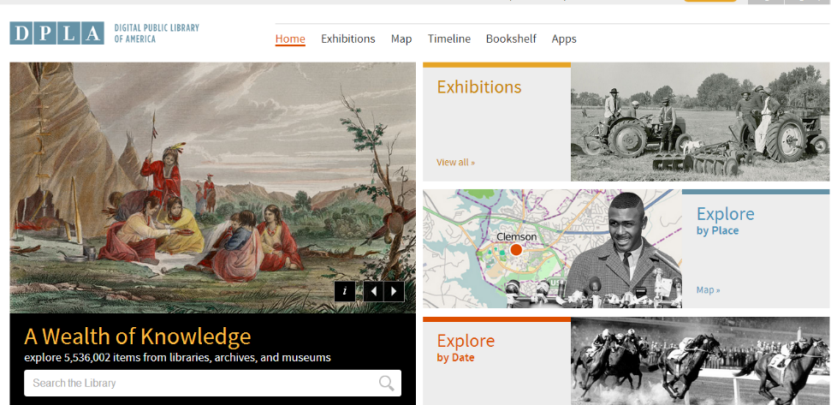
Digital Public Library of America http://dp.la/
Background
2009-present
Process and players
Functionality
Aggregation & links
Hubs
Exhibitions
Metadata
Apps
Strategy Plan 2015-2017
DPLA organization & staffing
Notes:
Nearly 11 million metadata records linking users to the digital objects.
Issued their strategic plan—they note that they need to complete the hub network so that all collections and item types in America have an on-ramp to DPLA; fully build out the technology platform to ensure a solid foundation that anticipates growth and diversification; and pursue an outreach plan that gets DPLA resources more widely into the hands of the global public, into education at all levels from kindergarten through graduate schools (with a special focus on underresourced organizations), and onto the screens of eager amateur and family historians and the developers who are creating the latest apps.

Slide 4
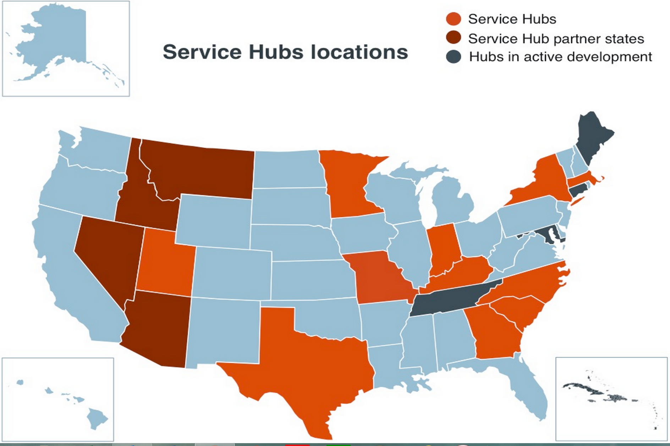
DPLA Service Hubs
SLIDE OF THE DPLA STATES/HUBS

Slide 5
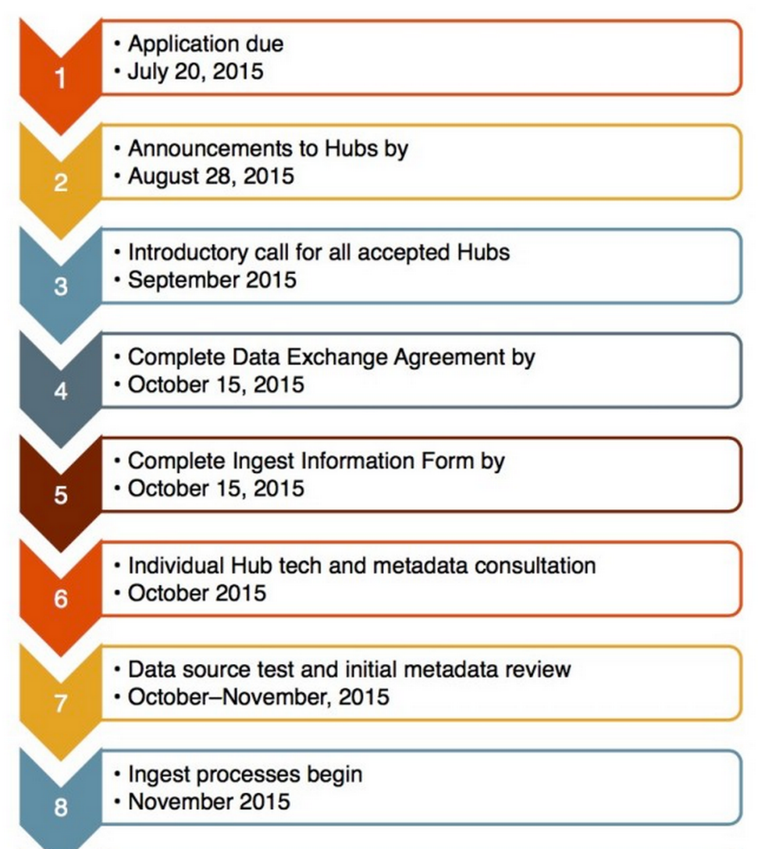
Becoming a Service Hub
10-12 new hubs
All 50 states by 2017
No one specific structure
Application
Staffing
Technical infrastructure
Metadata
Etc

Slide 6
Role of the Service Hub
Serve as the point of contact for DPLA; obtain community buy-in on significant issues affecting their partners
Aggregate partners’ metadata & share with DPLA
Actively address metadata concerns
Provide outreach to partners, and with DPLA staff, develop local practitioners’ capacity
Maintain technologies that allow for standardized metadata to be shared with the DPLA on a regular, consistent basis.
Engage with the broader community of data creators, providers, and users, locally and nationally.
Notes:
Representing their community (state, region, etc.) as the point of contact for DPLA and obtaining community buy-in on significant issues affecting their partners.
Aggregating their partners’ metadata into a single standard and sharing it with DPLA through one harvestable data source.
Actively addressing metadata concerns (including copyright and licensing labeling) and working with partners on timely remediation.
Providing outreach to their partners, and with DPLA staff, developing local practitioners’ capacity on topics such as open data, data quality and standards, copyright and licensing, and other relevant subjects.
Maintaining technologies (such as OAI-PMH, API, ResourceSync, etc.) that allow for standardized metadata to be shared with the DPLA on a regular, consistent basis.
Engaging with the broader community of data creators, providers, and users, locally and nationally.

Slide 7
Hallmarks of Success
Increased access to digital collections across multi-cultural heritage institutions
Strong statewide participation
Sustainability/longevity
Strong leadership
Standards for:
Metadata Creation
Content Creation
Long-term Access/Digital Preservation
Widely available/transparent policies

Slide 8
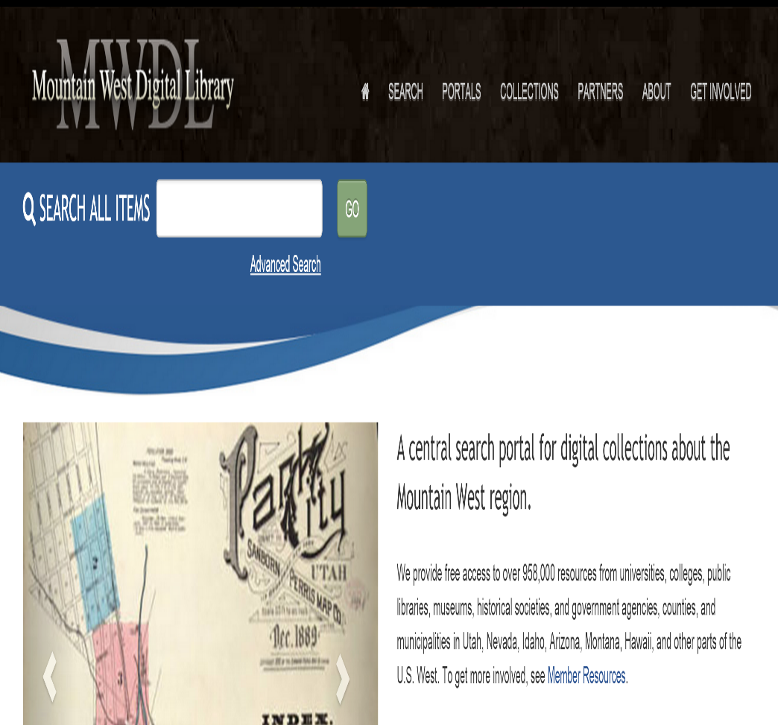
Mountain West Digital Library
Began in 2001 with IMLS LSTA Grant
958K items about the Mountain West in 581 collections
122 Partners across 6 states
Accessible at http://mwdl.org
Notes:
122 parterns across all types of cultural heritage organizations serving 5 states

Slide 9
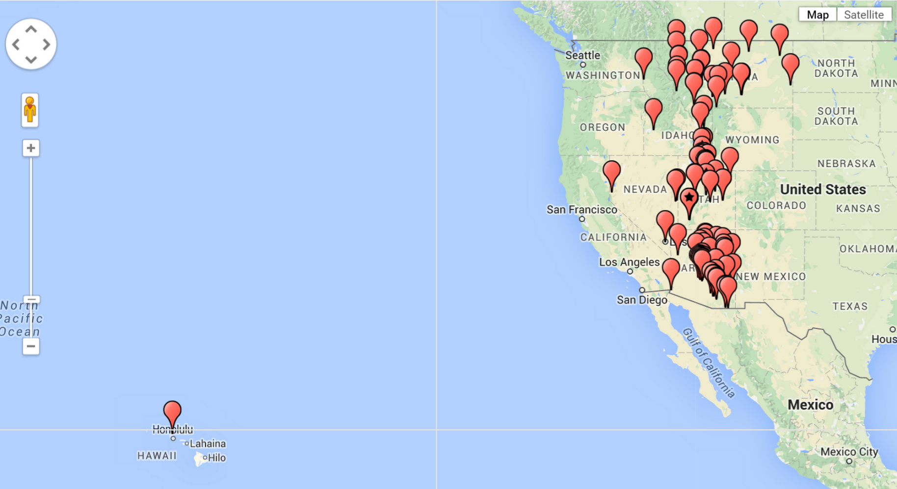
MWDL harvested sites

Slide 10
MWDL Infrastructure
Central Search Portal--Ex Libris Primo
Metadata index updated weekly--harvesting MWDL’s distributed network of digital repositories
Digital Asset Management systems used at MWDL repositories include:
CONTENTdm
BE Press
ArchivalWare
Equella
AXAEM
Existing in-house systems

Slide 11
MWDL General Guidelines for Digital Metadata
“Instructions for Collection Managers”
Includes
Mapping to Dublin Core
Locally and Centrally Searchable Fields
Date Fields Setup and Formatting
Copyright
Subsets of Controlled Vocabulary
Also includes additional detailed help

Slide 12
Repository for Harvest by MWDL
Offering a Repository for Harvest
What the Harvesting Organization Needs to Know
How MWDL uses OAI to harvest
Notes on the use of Open Archives Initiative (OAI) Protocol to harvest
Permissions (for inclusion to search)

Slide 13
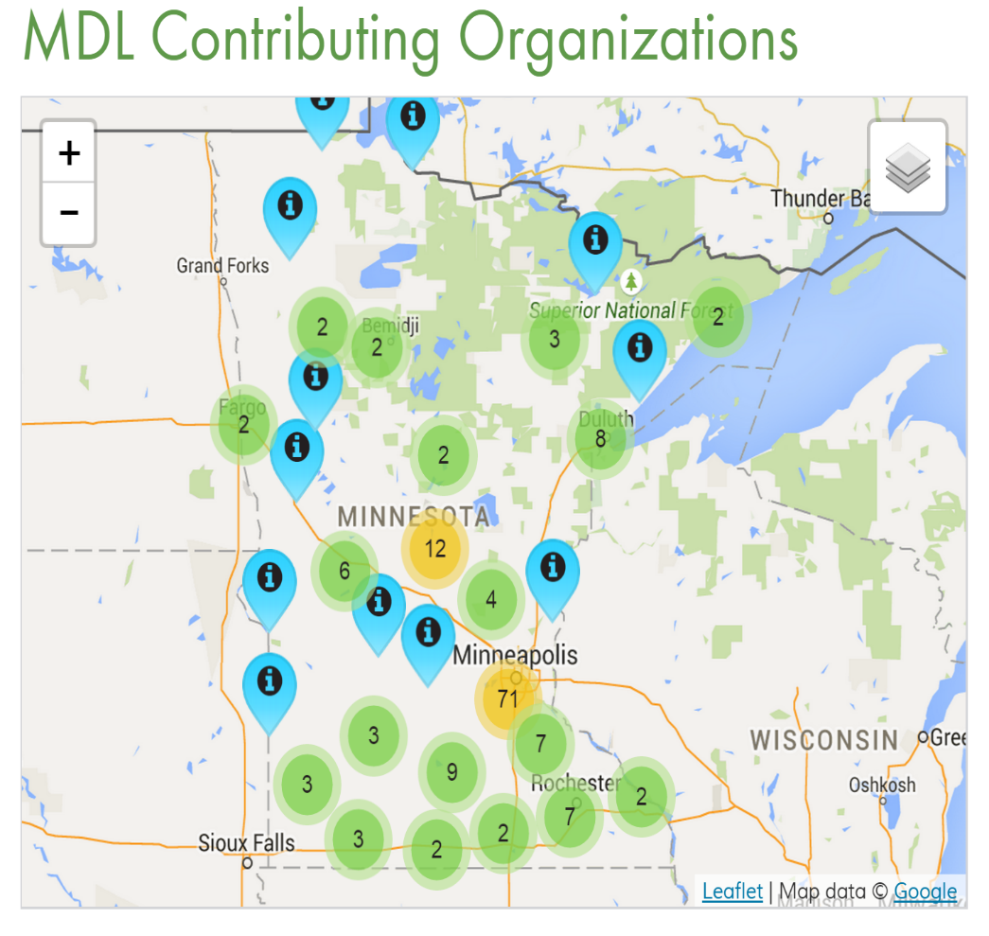
Minnesota Digital Library
“Minnesota Reflections” Project is main initiative; includes 169 partners; 230,000 items
469,000 items in DPLA
Administrative oversight via MINITEX
Available at: http://www.mndigital.org/
Notes:
Began in 2001,

Slide 14
MDL Policies
MDLC Policy on Digital Rights and Ownership (2004)
Minnesota Reflections Metadata Entry Guidelines
Interactive Tutorial and Worksheet Samples
Collaborative Digital Program (CDP) Best Practices Adopted by MDL
Dublin Core Metadata Best Practices
Digital Imaging Best Practices
Digital Audio Best Practices

Slide 15
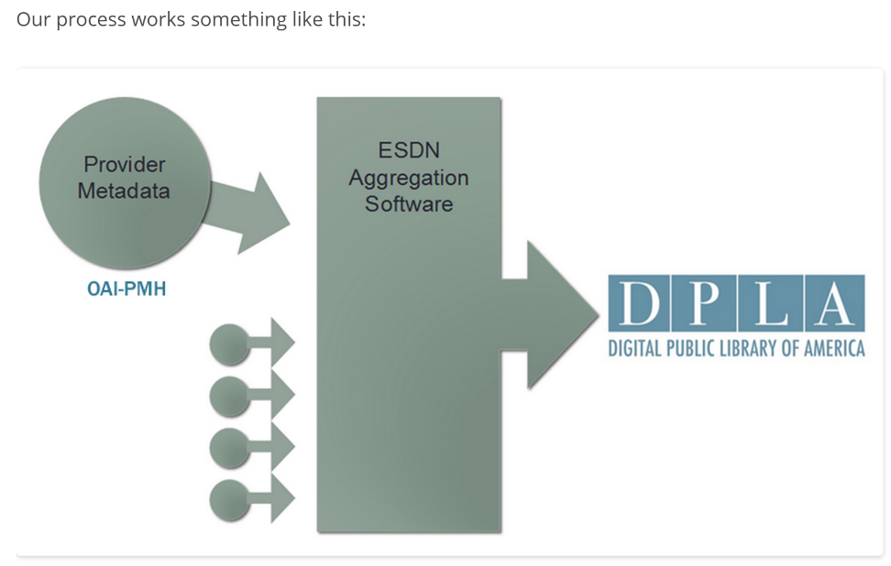
Empire State Digital Network (NY)
Initiated project mid-2013
79K records loaded Jan, 2015
Phased approach
Existing digital collaboratives &
Independent sites
Defined roles for regional networks
Notes:
ESDN is a dark repository, public access is still through the existing digital collaborative programs who operate content management systems, such as Western NY Regional Library Council. One regional council, Metropolitan Library Council is the lead on the project and manages the aggregating of the metadata, the relationship with DPLA and the agreements with the partner libraries.
Developed support materials for metadata analysis

Slide 16
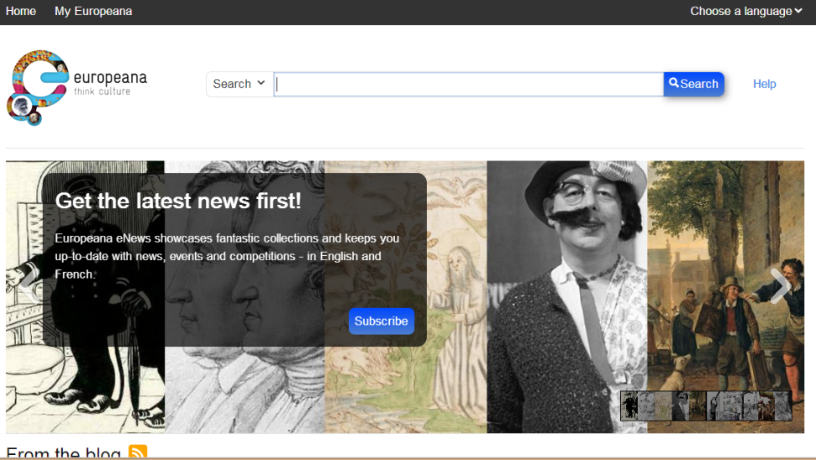
Europeana http://www.europeana.eu/
Background
2005-present
Key players
Functionality
Aggregation
Local hosting
Metadata
Strategy/Vision
Aggregate
Facilitate
Distribute
Engage

Slide 17
National standards and best practices

Slide 18
What do we know?
What’s the Ohio digital environment?
What’s the Ohio metadata environment?
What do we need to find out?

Slide 19
What does DPLA require?
DPLA Metadata Application (API)
Copyright statements
Data Use Policy
Creative Commons—CC0
Issues faced by other service hubs

Slide 20
DPLA and Metadata
Assumptions about metadata
Metadata is not subject to copyright restrictions
Partners share the DPLA’s vision of and commitment to freely sharable metadata
DPLA asserts no rights over its database of metadata…
Free and unencumbered access to metadata.
Notes:
Given the purposes of the policy and the copyright status of the metadata, and pursuant to the DPLA’s terms of service, the DPLA’s users are free to harvest, collect, modify, and/or otherwise use any metadata contained in the DPLA

Slide 21
DPLA Metadata Application Profile V 4.0
Based on Europeana Data Model
Uses elements similar to Dublin Core and RDF
API is a set of metadata elements taken from multiple schema
Describes entities and the relationship between them
Important to understand the Ohio metadata and how it will aggregate
Notes:
Introduced in 2013, now in version 4. Based on the Europeana Data Model, the elements in the metadata profile is based on DC and RDF, plus some additional elements special to DPLA, such as elements supporting the aggregators and geographic elements. Profile designed to support contribution by the hubs
DPLA’s MAP is an application profile, or a set of metadata elements, taken from multiple schemas for a particular local use. It is also a semantic metadata model, or an abstract structure that describes the relationships between different types of data about the same thing. This means it is more robust and abstract than a metadata schema like Dublin Core or MODS in that it describes entities and the relationships between them. Entities are things like the resource being described, the record describing it, the person who created it, and the place it is located. By describing these entities independently and then creating relationships between them, DPLA can create a more dynamic and efficient metadata store.

Slide 22
DPLA and Rights statements
International initiative
Problem—Little or no guidance to users
Who’s the owner
Who to contact
What they can do with the digital resource
Analyzed 1.4M rights statements
50%--All Rights Reserved
13%--Public domain
7%--No rights statement
3%--Creative Commons Statement
Notes:
DPLA, Europeana, Digital NZ and Trove, an Australian initiative have established an international project to address the issue of rights statements. project will bring together these important collections to harmonize and evangelize a simpler rights structure, one that includes ways for works of all types, including works with unclear or no known rights, to be put online and made available to the public. An analysis of 1.4M rights statements in DPLA found that 50% said All Rights Reserved, 13% were in the public domain and 3% had a Creative Commons statement, while 7% had no rights statement

Slide 23
Rights statements—MWDL sample
©[copyright holder’s name], [date of creation for the work]. This item is available under a Creative Commons CC BY-NC-ND license. The license allows this work to be downloaded and shared with others with proper attribution to the copyright holder, but this item cannot be changed in any way or used for commercial purposes. For more information about this license go to http://creativecommons.org/licenses/by-nc-nd/4.0/
Any user who finds this partner's items online now knows exactly what they can legally do with the work. They can share it and use it for scholarly/ educational purposes. They cannot,however, alter the items (sorry, no funny memes) and they can't profit off the item commercially (e.g., you can't print the items on aprons and sell them).

Slide 24
Questions and Discussion
Liz Bishoff
The Bishoff Group
303-908-6736
Liz.Bishoff@gmail.com
Tom Clareson
LYRASIS
614-439-1796
tom.clareson@lyrasis.org

