Slide 1
Ohio DPLA Survey Results
Tom Clareson and Liz Bishoff
Ohio DPLA Symposium
December 3, 2015

Slide 2
Key findings
128 organizations reported having digital collections. These would be the focus of the first three years of Ohio DPLA activity.
Respondents have created or collected a range of formats of materials. It will be important to define what subject areas or themes will be targeted for harvesting.
The most commonly used digital asset management system used is CONTENTdm. However, 38 did not have a system and 12 did not know what system they had.

Slide 3
Key findings
Organizations likely to be most ready to have their collections harvested would be those who have implemented the OAI-PMH protocol. 23 have implemented; 7 have systems that support OAI-PMH but have not implemented it.
The majority of digital collections reported in the survey were small (less than 10,000 metadata records), but 35 organizations had between 10,001-999,000 metadata records that were publicly accessible.
Most respondents felt very confident about determining copyright for their digital resources, but fewer had actually recorded information regarding rights.
There is a strong need for education on digitization, copyright, metadata, and harvesting issues.

Slide 4
Project Background
Survey sponsored by the Ohio Digital Public Library of America Project Steering Committee
Purpose: to identify current digital activities of Ohio’s cultural heritage organizations, and interest/readiness to participate in DPLA
Project funded in part through a federal Institute of Museum and Library Services LSTA grant awarded by the State Library of Ohio to Columbus Metropolitan Library

Slide 5
Survey Responses
Survey in field October 1-26, 2015
219 total responses
Largest response groups by type:
Public Libraries (107; 48.7% of total)
Academic Libraries (68 responses; 31%)
Archives (29 or 13.2%)
Historical societies/history museums (10 or 4.6%)
Majority of respondents had primary role of administrator/director/dean, librarian, digital librarian, or archivist

Slide 6
Ohio’s Digital Collections
128 responding institutions (59%) have digital collections
Of the 89 (41%) that did not
30 replied that they would begin creating digital collections in the next three years
59 will not create digital collections

Slide 7
Digital Collection Creation & Born Digital Creation/Acquisition
Source materials for digitized collections
Photo prints (80.6%)
Texts/Manuscripts (62.7%)
Newspapers on Paper (50%)
Maps/arch.drawings/ posters (45.5%)
Books (45.5%)
Digital Resources in Collection:
Documents – 75.7%
Digital Photographs – 67.2%
Digital video – 44.3%
Digital audio – 41.2%

Slide 8
Copyright and IP Issues
A key to successful participation in DPLA is having the rights to provide access to digital collection materials
Most survey respondents felt confident in determining copyright status of their collections
Survey collected samples of copyright statements from 40 organizations

Slide 9
Digital Asset Management Systems
Top systems in use in Ohio
OCLC’s CONTENTdm (54 organizations)
PastPerfect (18)
Omeka (15)
BePress Digital Commons (15)
Locally-developed system (15)
38 respondents didn’t have a DAM
12 did not know what system they had

Slide 10
Metadata Issues
A Key to DPLA Success

Slide 11
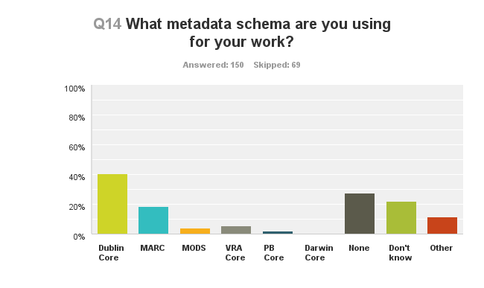
Metadata Schemas Used
Dublin Core – 61 (40.7%)
None – 41 (27.3%)
Don’t Know – 33 (22%)
MARC – 28 (18.7%)

Slide 12
Cataloging Standards/Controlled Vocabularies
Library of Congress Subject Headings – 49 (32.7%)
None – 39 (26%)
Anglo-American Cataloging Rules 2 (AACR2) – 37 (24.7%)
Don’t Know – 29 (19.3%)
Describing Archives: A Content Standard (DACS) – 23 (15.3%)
Art and Architecture Thesaurus (AAT) – 23 (15.3%)

Slide 13
Metadata Records Available
Number of Records | Number of Organizations | Percentage
1-10,000 | 53 | 38.13%
Zero | 51 | 36.69%
10,001-25,000 | 13 | 9.35%
25,001-50,000 | 8 | 5.76%
50,001-100,000 | 8 | 5.76%
100,001-250,000 | 4 | 2.88%
250,001-500,000 | 1 | .72%
500,001-999,000 | 1 | .72%

Slide 14
Metadata Harvesting Strategies
49 (34.3%) don’t know
47 (32.9%) do not support any harvesting capability
25 (17.5%) support Excel/CSV (data export)
23 (16.1%) support Open Archival Information for Metadata Harvesting (OAI-PMH)
13 (9%) File Transfer Protocol
6 (4.2%) support Z39.50

Slide 15
Working Together
Collaboration and Education Issues

Slide 16
Collaborative Digital Activities
78 respondents (52.7%) do not currently collaborate with other CHIs on digital initiatives; 45 (30.4%) do
14 (9.5%) institutions participate but are not currently active
11 (7.4%) don’t know
Top collaborative groups/partners:
Ohio Memory
Cleveland Memory
Columbus Memory
Digital Shoebox
Summit Memory
Five Colleges of Ohio

Slide 17
Need for Education
Topics for education include:
Digitization and born digital materials
Copyright and other intellectual property issues
Metadata Schemas and Cataloging Standards
Metadata Harvesting Capabilities

Slide 18
For more information
Tom Clareson, LYRASIS
Tom.Clareson@lyrasis.org; 614-439-1796
Liz Bishoff, The Bishoff Group
Liz.Bishoff@gmail.com; 303-908-6736

