Slide 1
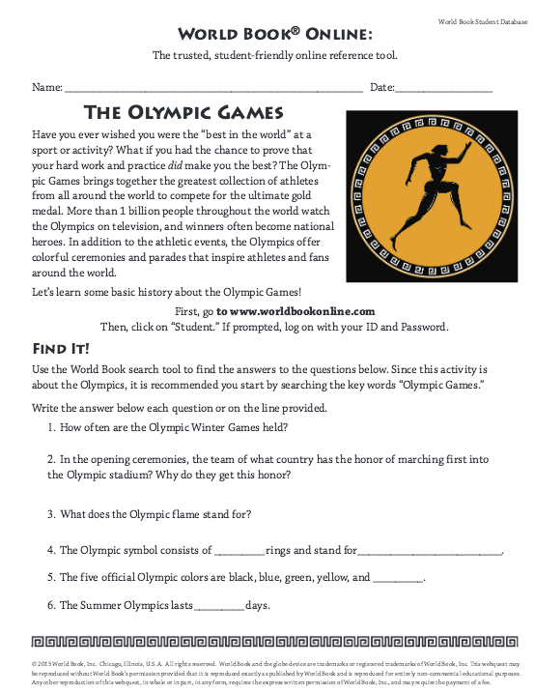
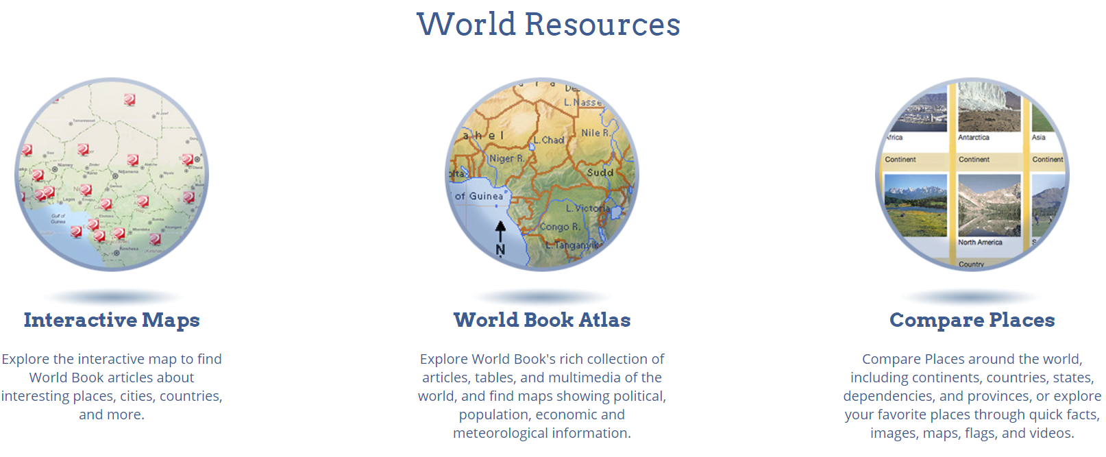
What’s New At World Book
Webquests
Early World of Learning facelift
Interactive Maps
Compare Places
World Resources navigation

Slide 2
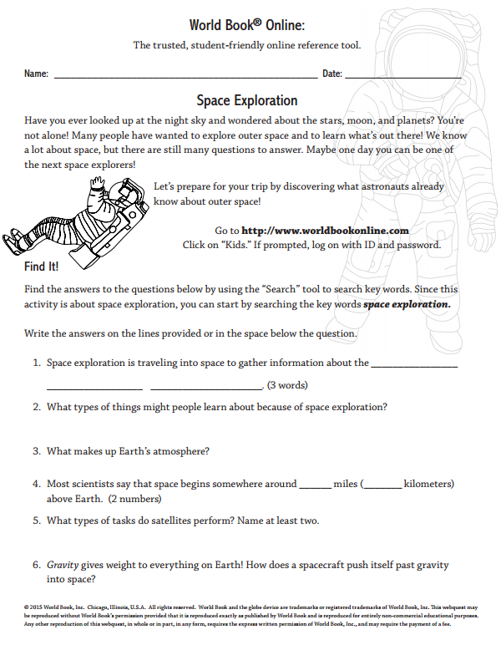
Webquests
Grade-specific expeditions on key topics designed to build foundational knowledge
Solve the webquest by using and exploring the reference material housed within World Book Online!
Print-and-go
NEW webquests added regularly!
Available on World Book Kids, World Book Student, and World Book Advanced.
Webquests can be found under the For Educators tab, and include a Teacher Guide with an Answer Key.

Slide 3
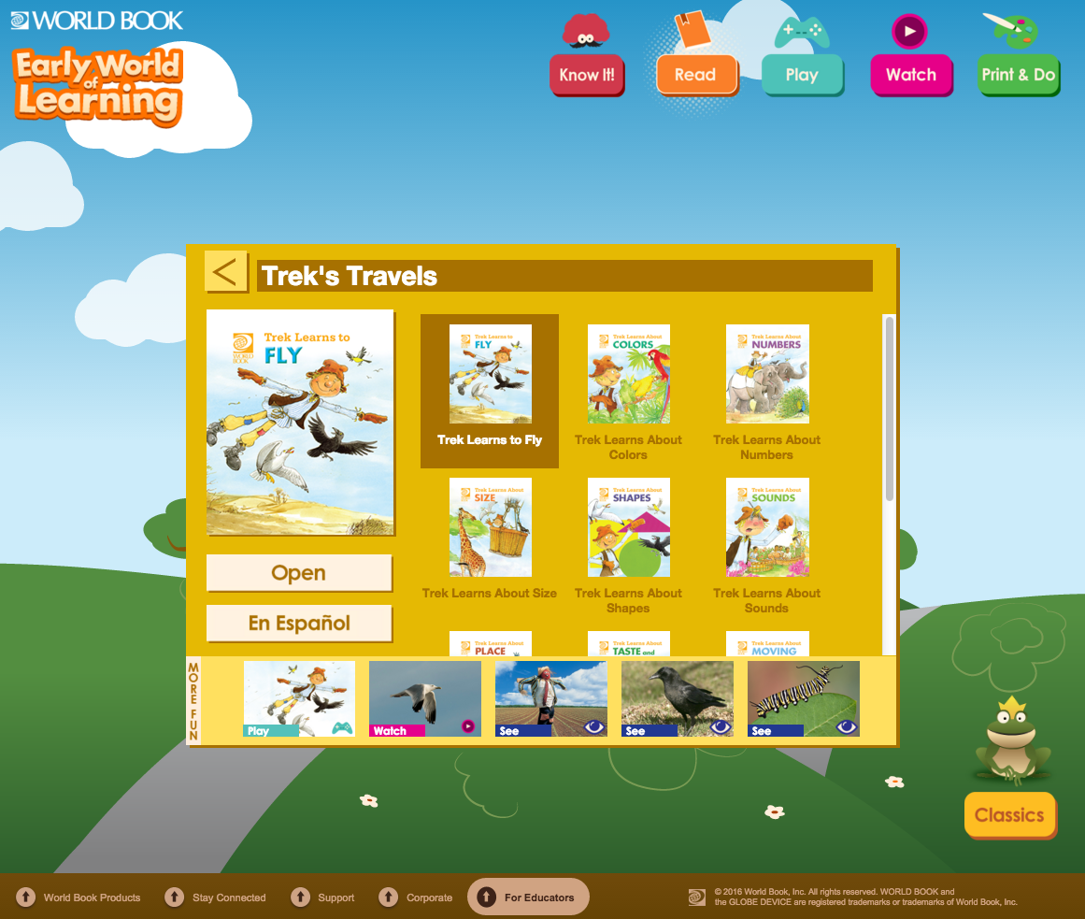
Early World of Learning
EWOL has been given a facelift to create an even more user-friendly platform for our youngest learners.
The landing pages for Trek’s Travels and Welcome to Reading now feature easy-to-use, tile-based interactions to help guide young users through the fantastic content of EWOL!

Slide 4
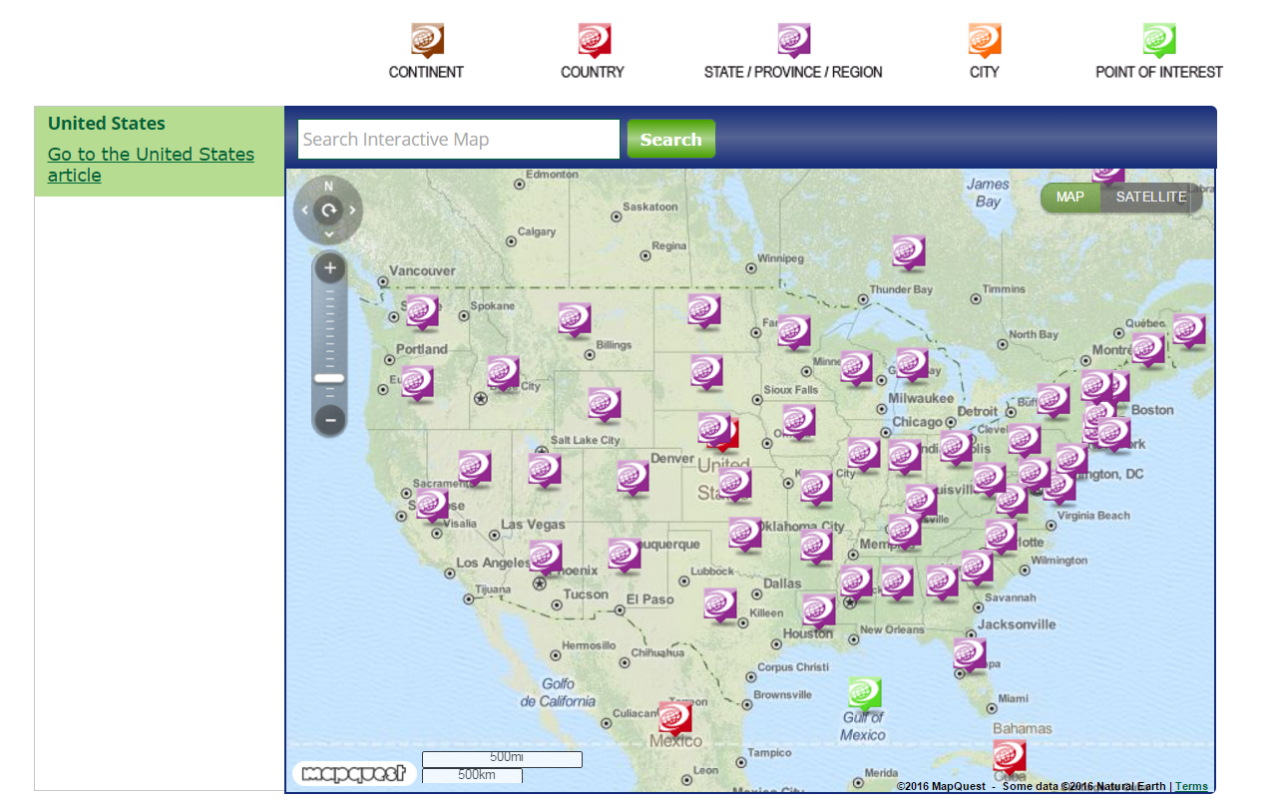
Interactive Maps
Interactive Maps are now on World Book Student and World Book Advanced!
Interactive Maps integrate World Book articles into a searchable, interactive interface.
Exploring the maps have never been easier! Articles display as pins dropped on the map at their latitude and longitude coordinates.
Controls can be zoomed, searched and toggled between satellite and map views.

Slide 5
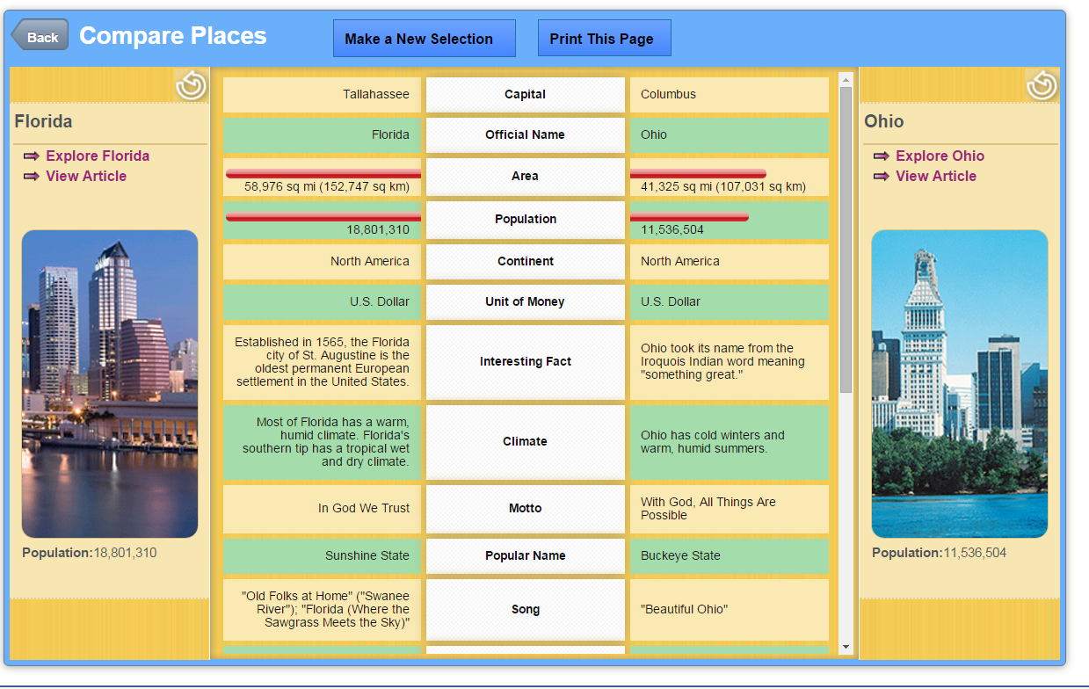
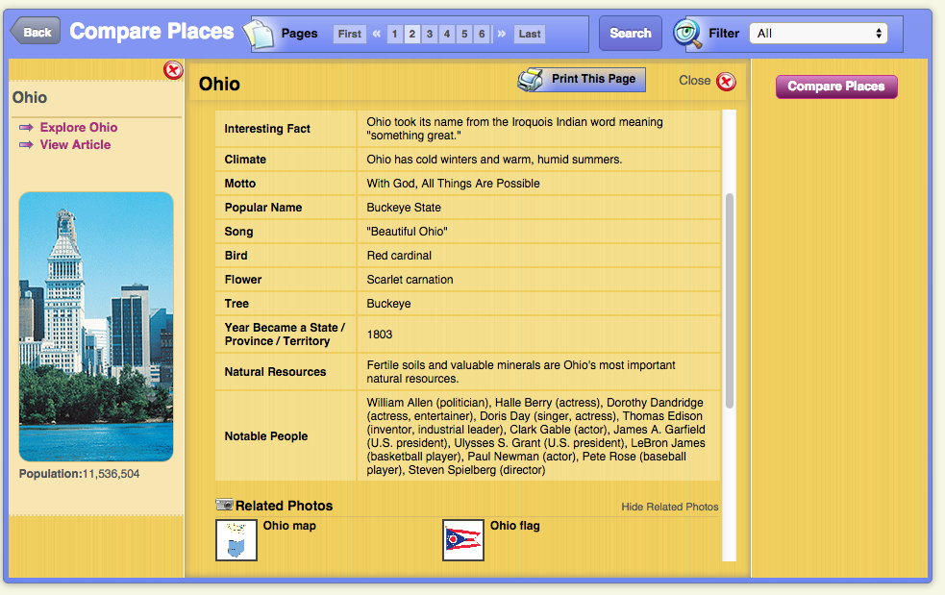
Compare Places
Compare Places has been added to World Book Advanced!
Compare continents, countries, states, providences, and dependencies
Includes flags, seals, population, maps, images, quick facts, state seals, and much more!

